Slide 1

THE VISUAL SIGN SHOP

Slide 2
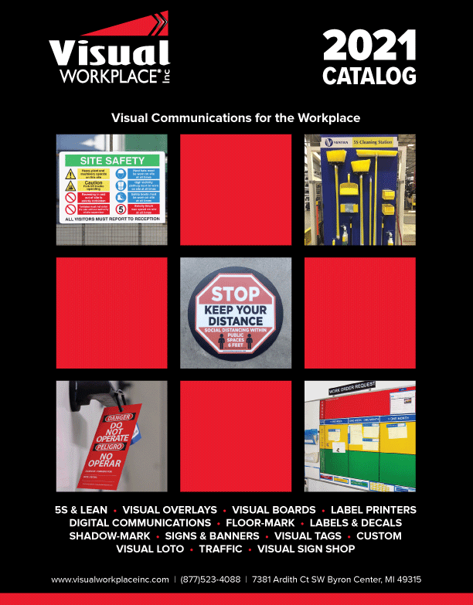
The Visual Sign Shop
Sales Tools
The Visual Sign Shop Overview
Training Overview
Victor Mondragon
Next Steps
Notes:
Thank you for your time today! We would like to give you a brief overview of our meeting today. We will be sharing our Visual Sign Shop and the sales tools we have available to support your team. Primarily we want to share a presentation that you can use with distributors to help them understand the product and engage them to present it to their customers.
We will also give some in depth information about our training program, share the sales tools we discuss today and talk about the next steps.

Slide 3
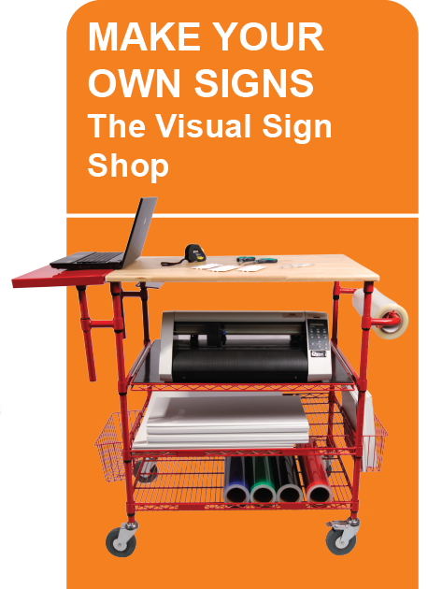
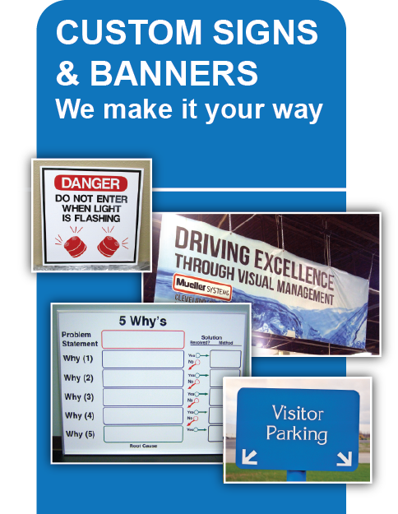
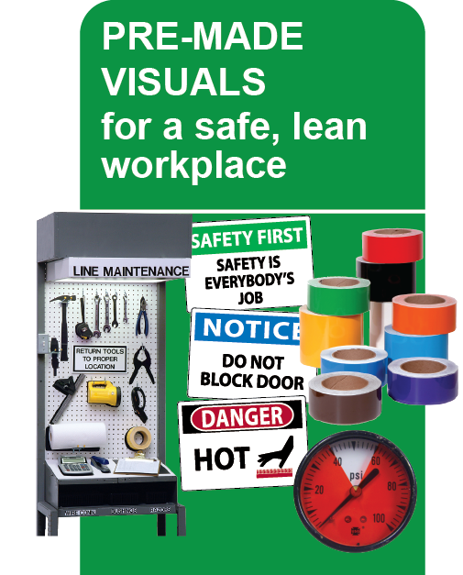
Visual Workplace Inc. & OneSolution
The leading provider of innovative visual communications that deliver a platform of
continuous improvement and drives sustainability within the workplace.
Visual Workplace and OneSolution partner to provide the visual communication expertise increasing productivity, cost savings and compliance for your customers.
Notes:
Just a brief overview of Visual Workplace and how we work with OneSolution to provide innovative visual communications that deliver a platform of continuous improvement and drives sustainability within the workplace Together we have the product expertise, support and tools to help distributors successfully deliver visual products to their customers.
Visual Workplace has been in business for 24 years and has built an extensive product offering that promotes Safety, Continuous Improvement, Lean and 5S.
Today will be talking about the Visual Sign Shop but we also provide solutions for customs signs and many products such as floor tapes, tool shadow boards, LOTO, tags and labels.

Slide 4
Visual Sign Shop Sales Tools
Proposal (Share Point)
12-page overview showing the value of VSS along with the components of system
Training Overview for Distributors (Share Point)
How can we work together to maximize the customers use and capabilities?
Samples
We offer sample signs created with the VSS for customer to review
ROI Calculator
Calculate your payback comparing the cost to make vs buying a custom signs
Visual Sign Shop Product Overview (Share Point)
Visual Sign Shop Product Flier (Share Point)
Videos
The Visual Sign Shop
How to make a sign in 4 Steps
L3 Harris Case Study
Case Studies (PDF)
L3 Harris – Defense
Magna – Automotive
Southwest Cheese – Food
Ventra – Automotive
Notes:
The Visual Sign Shop is a very unique product offered exclusively by Visual Workplace. Many others claim that their label printers make signs, but this is just not true. To better assist our distributors in presenting this product we have put together a sales tool kit with many different options to help you educate your customers on the possible applications and capabilities. These tools will provide valuable information to your customers and create a compelling reason for them to want to make your own signs and visuals.
We will go into more detail in just a little bit. First, we want to take you through the first tool. The Visual Sign Shop Product Overview.

Slide 5
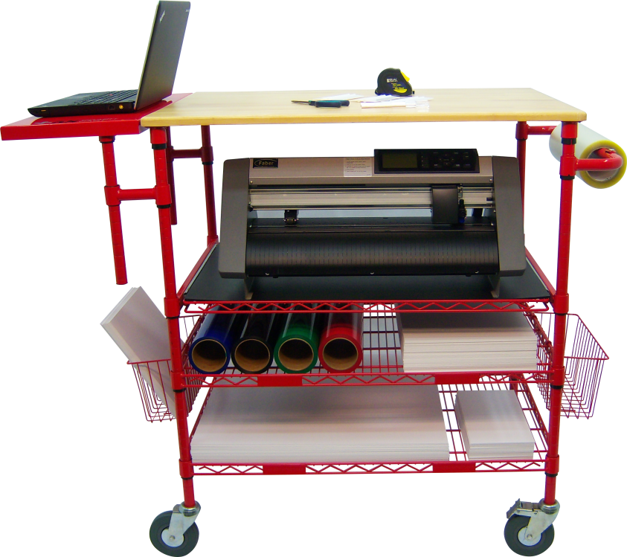

What is the Visual Sign Shop?
The Visual Sign Shop is the ultimate tool to create visual communications in a facility.
It contains everything needed to make your own visuals on demand for a fraction of the cost to buy them!
Laptop & Sign Making Software
Mobile 5S Crash Cart
Vinyl Cutting Plotter
Sign Making Tools
Supplies for 64 Signs
Training
Technical Support & Manuals
Live Web Demos
Watch to lean more!
Notes:
Organizations lack the proper tools to create visual signs internally. They use what they have available or purchase from an outside resource that can be costly. We have developed a product that is designed specifically for facilities to make their own signs. It includes everything needed to make your own signs. We provide training, tech support, templates, and online resources to make it easy to use. Now 5S organization, work instructions and safety requirements can be standardized.
The laptop is an optional component. In our experience, 80% of the customers opt for the laptop. It simplifies the setup and they do not have to involve their IT team and navigate their requirements. The laptop comes with the software loaded and ready to plug and play.
We included a cart to make the system mobile allowing it to be moved around easily. This is especially helpful for companies that utilize Kaizen (continuous improvement) events. Presenting the sign shop as tool to be used for Kaizen events can be a great selling point.
The sign shop includes tools to make 64 signs. We remind prospects that this offsets the cost of the sign shop if they calculate the cost make vs buying these signs.
The most important part about the sign shop is the support and resources we provide. Buying all of the items ala carte and trying to do this yourself is nearly impossible. We built a support model for this product that helps customers maximize their applications of this products with one resource.

Slide 6
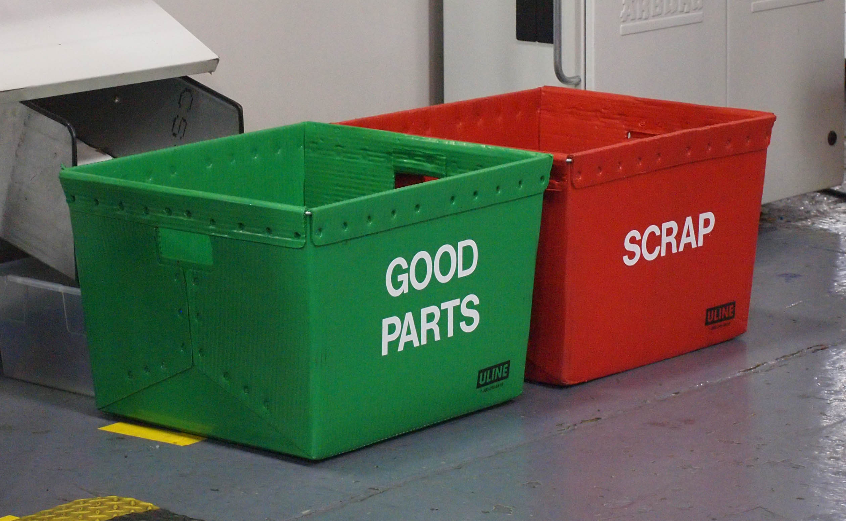
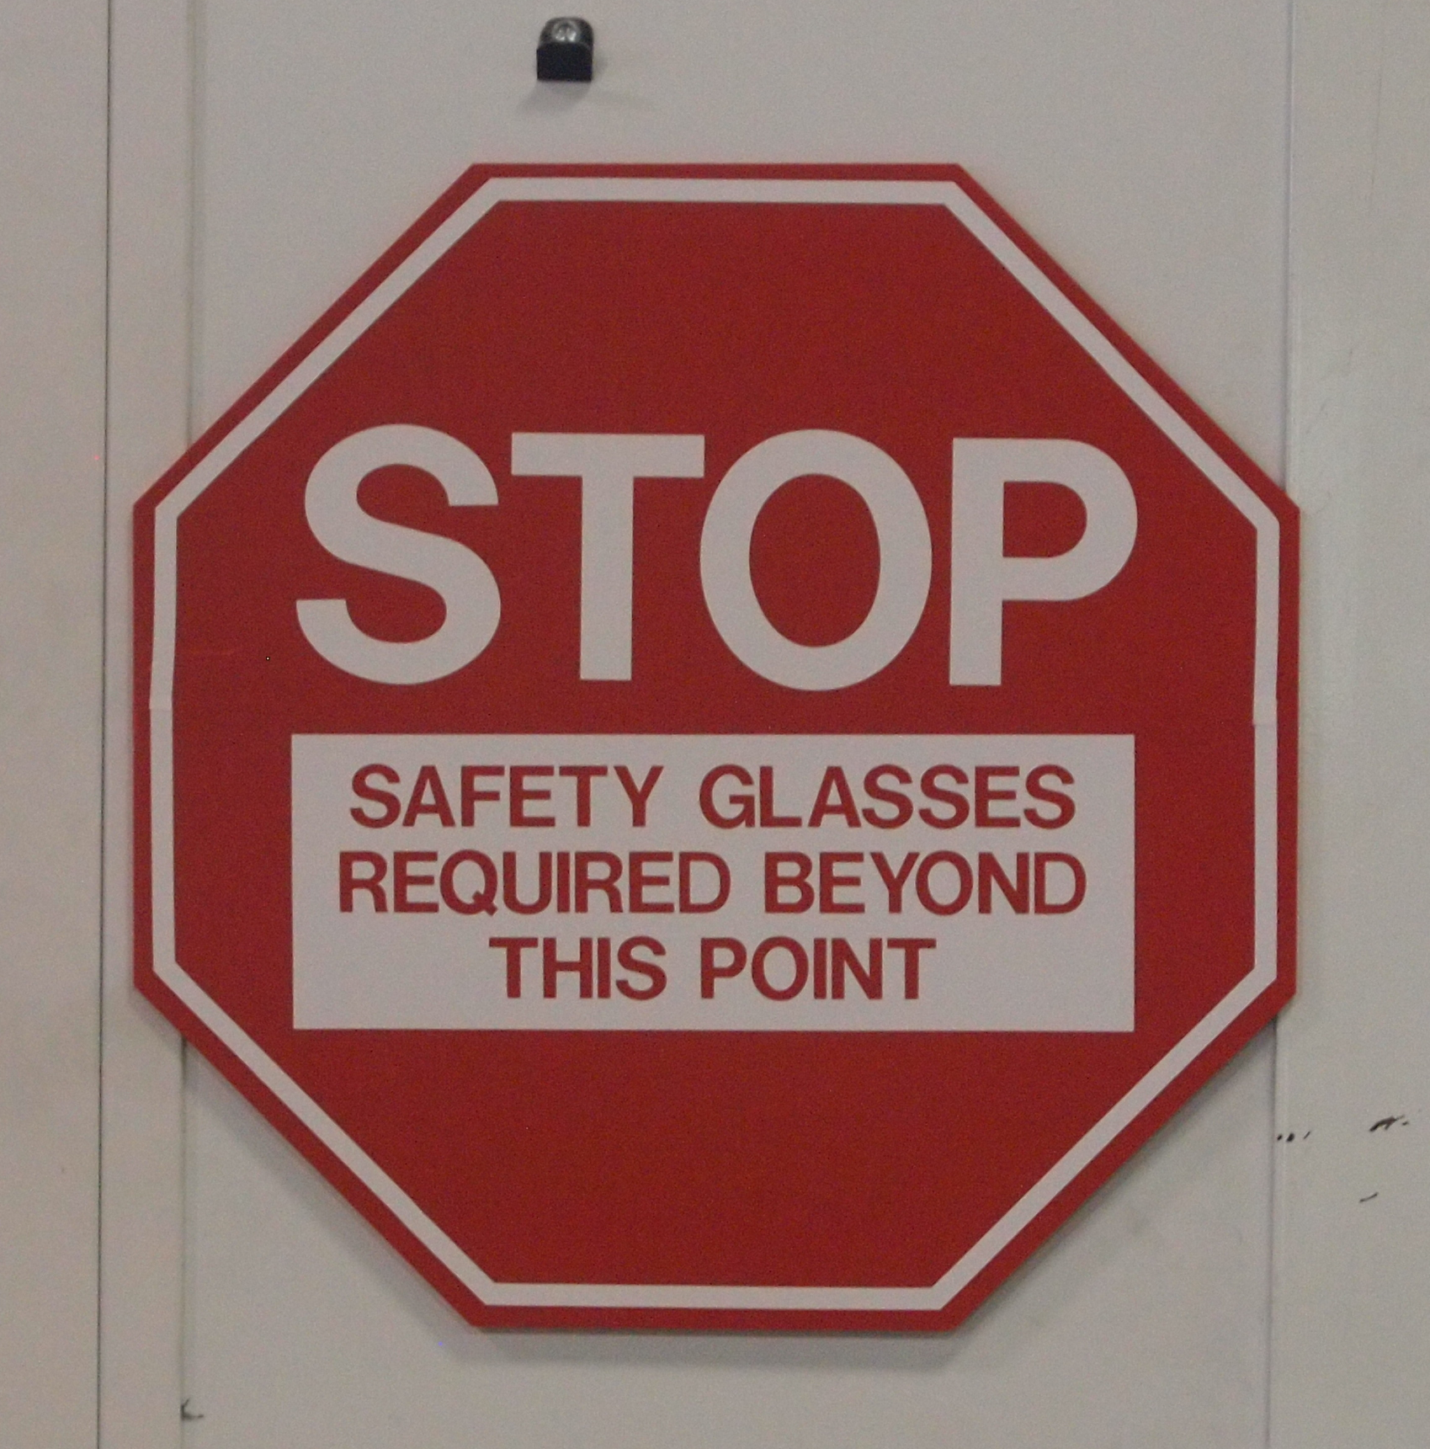
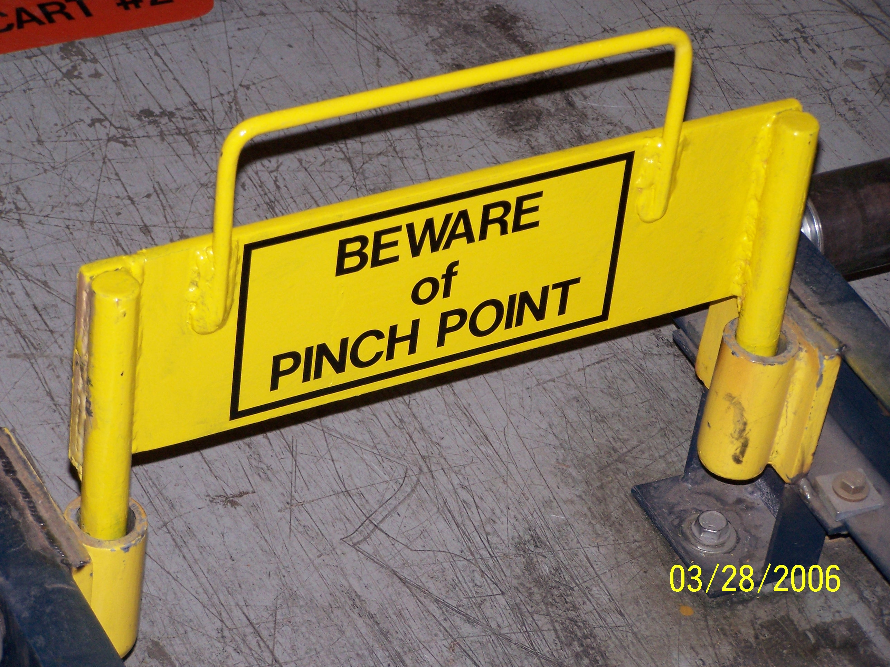
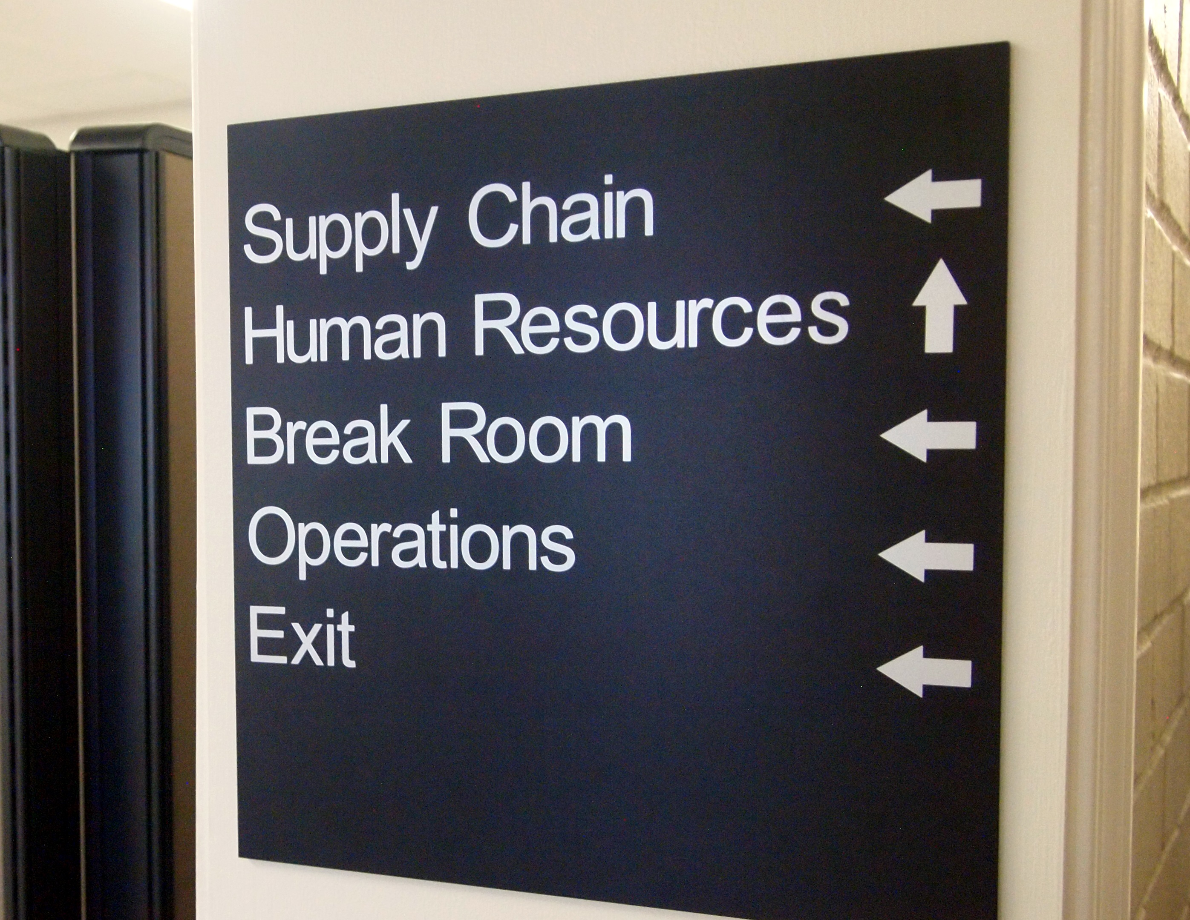
What is Visual Communication?
Visual Communication is the conveyance of standards and information directs behavior at the point of use. We are surrounded by Visual Communication every day directing our behaviors to promote Continuous Improvement, while keeping us safe and informed.
It is imperative to have proper visuals in the workplace and they affect us in many ways through:
Cost Savings
Safety
Organization
Metrics
Notes:
Visual Management is a critical component to a Lean workplace. Many facilities have the desire to manage their organizations visually but lack the tools to do it effectively. Visual Workplace provides everything they need.
Our goals is to direct behavior, promote continuous improvement while working safely. This can only be done with the use of visual communications. As you can see in these examples, visual communications come in many forms. It is important to help you customers create that understanding. If you find that your customer needs help, the Visual Workplace team can provide presentations to their team create understanding!

Slide 7
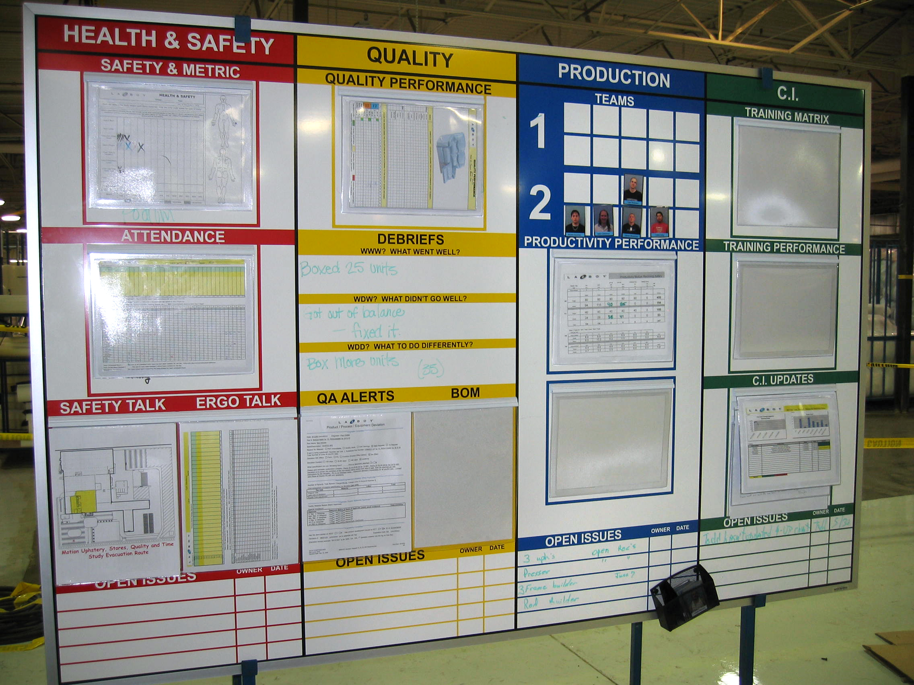
Visual Communications are a priority to create a lean and safe workplace!
Identify abnormal and critical situations
Organize workplaces
Create visual standards for a safe work environment
Visualize standard processes
Notes:
We want to create organization, reinforce safe work requirements and standardize our processes.

Slide 8
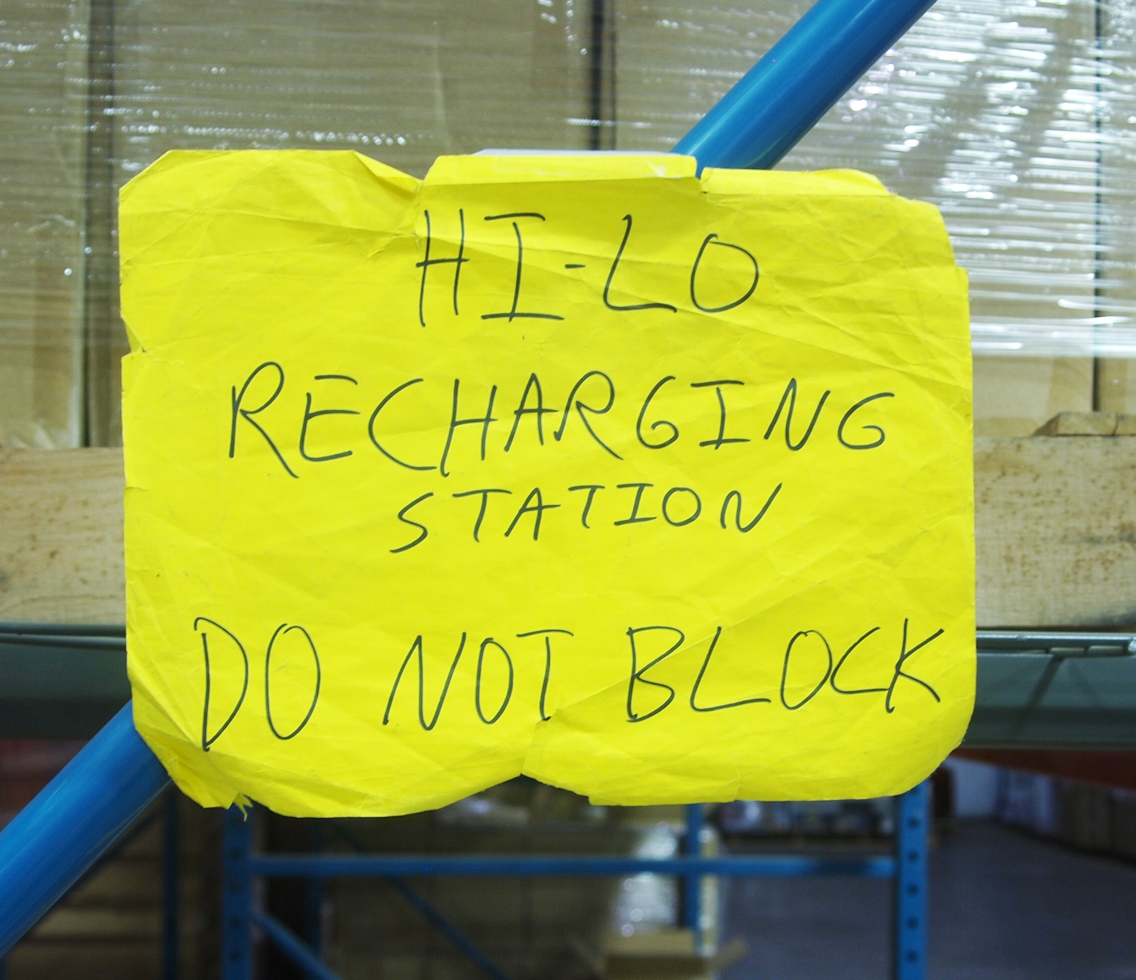
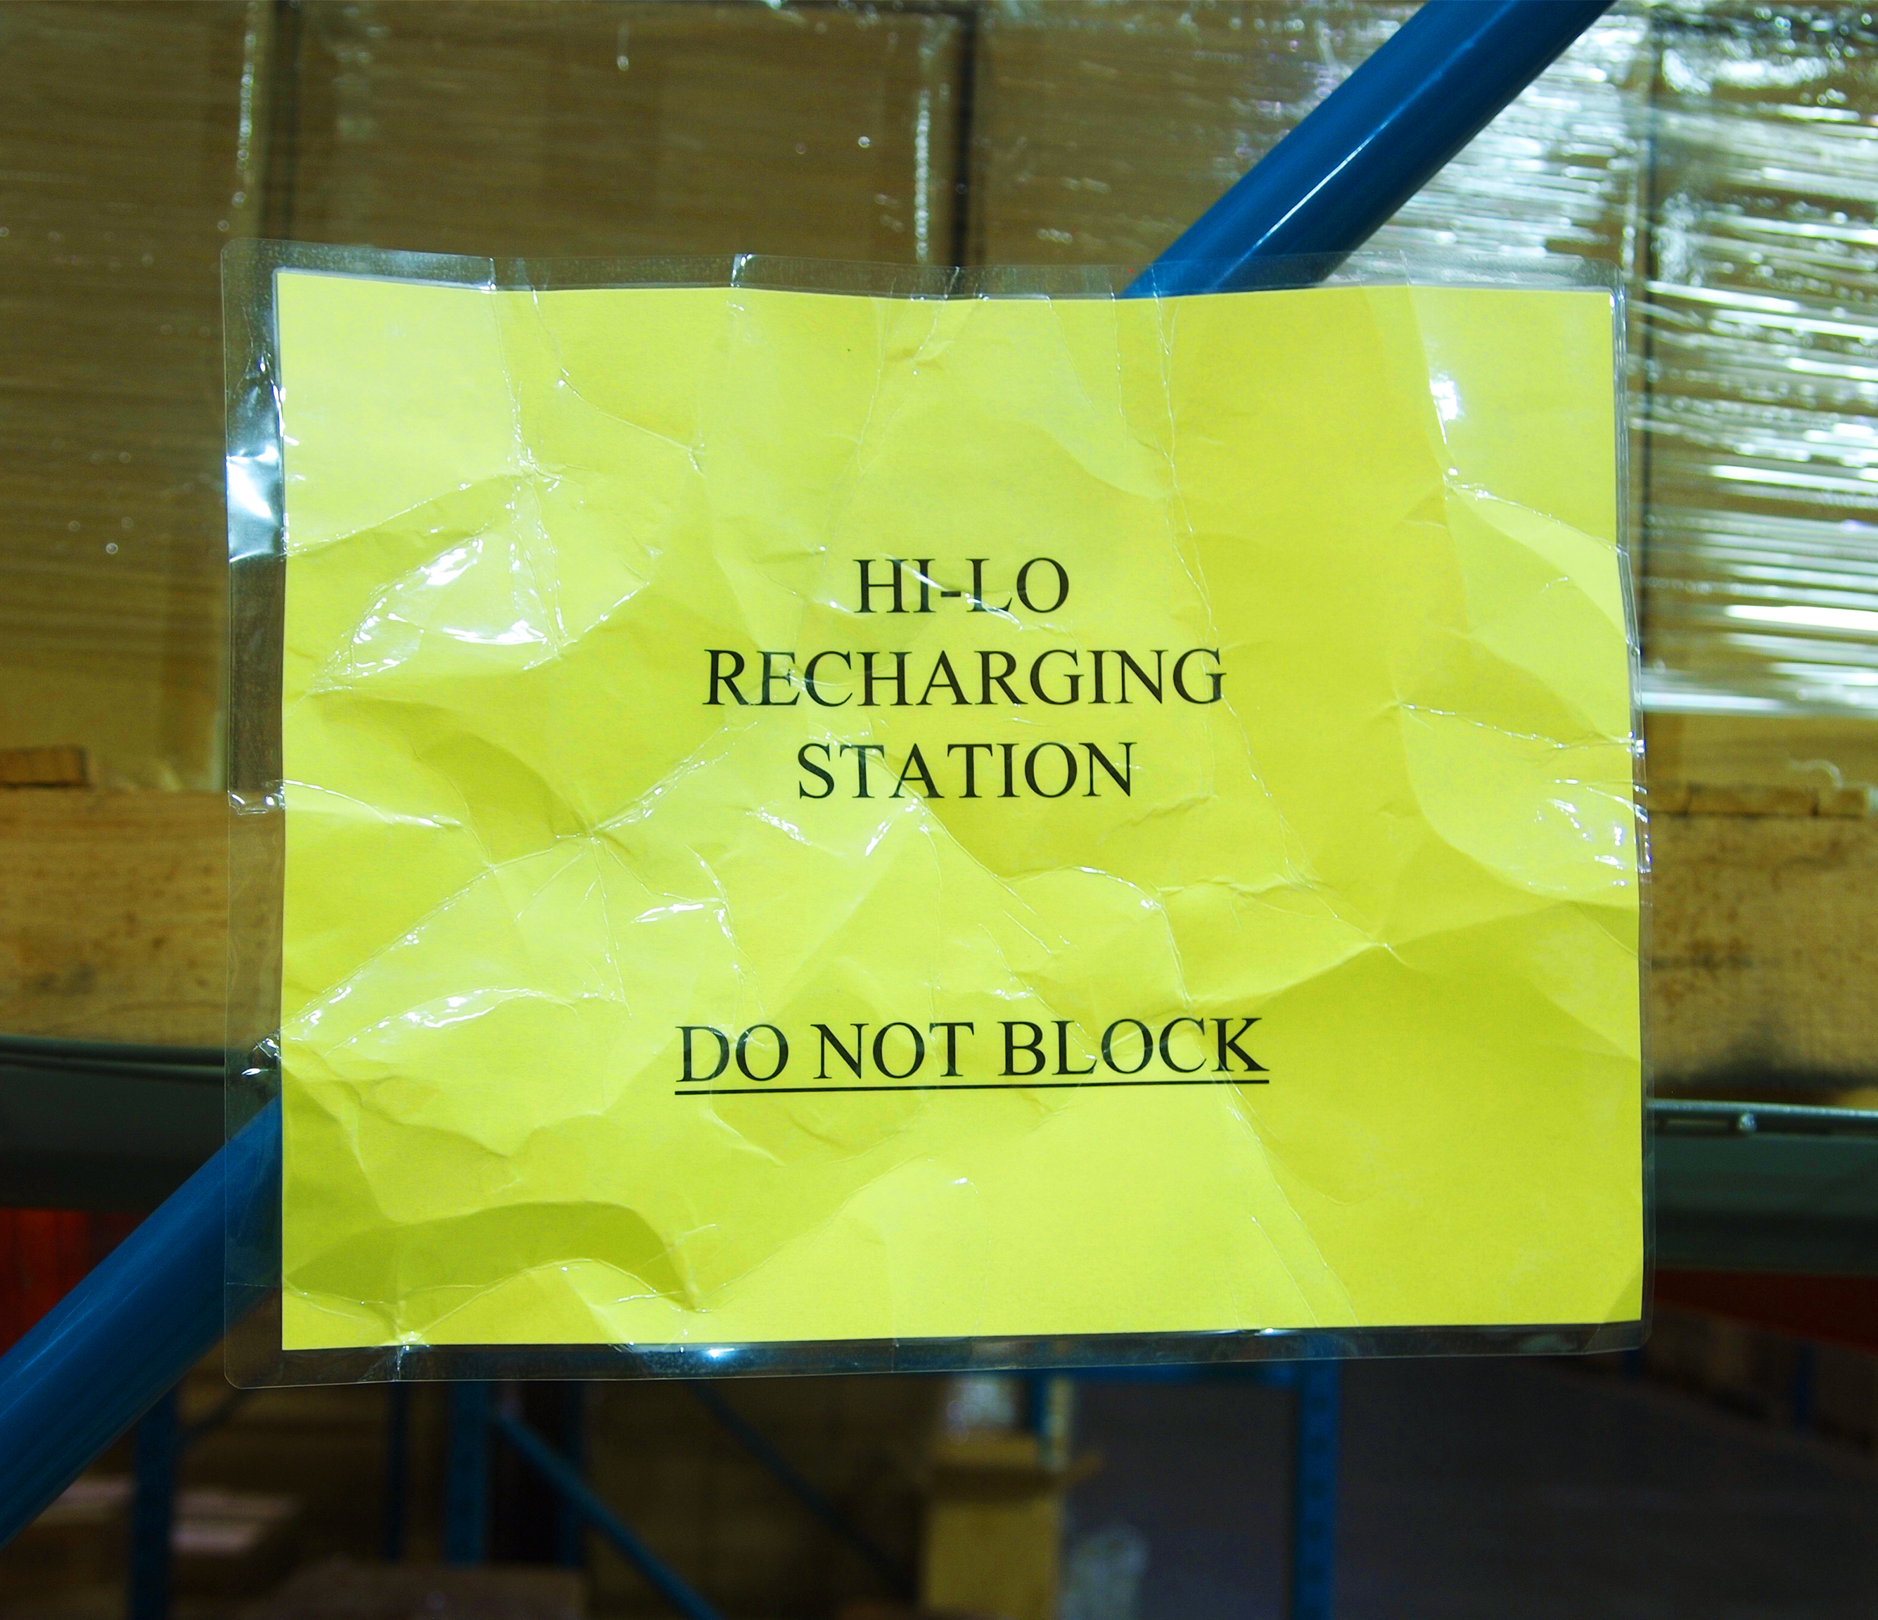
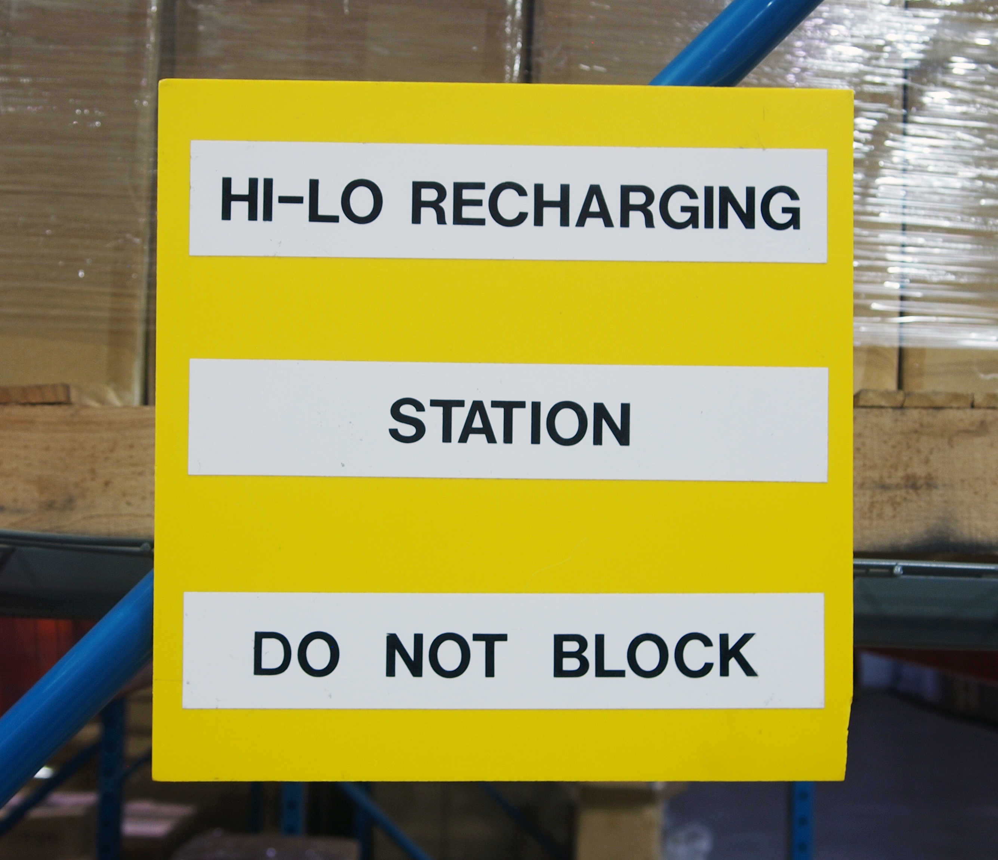
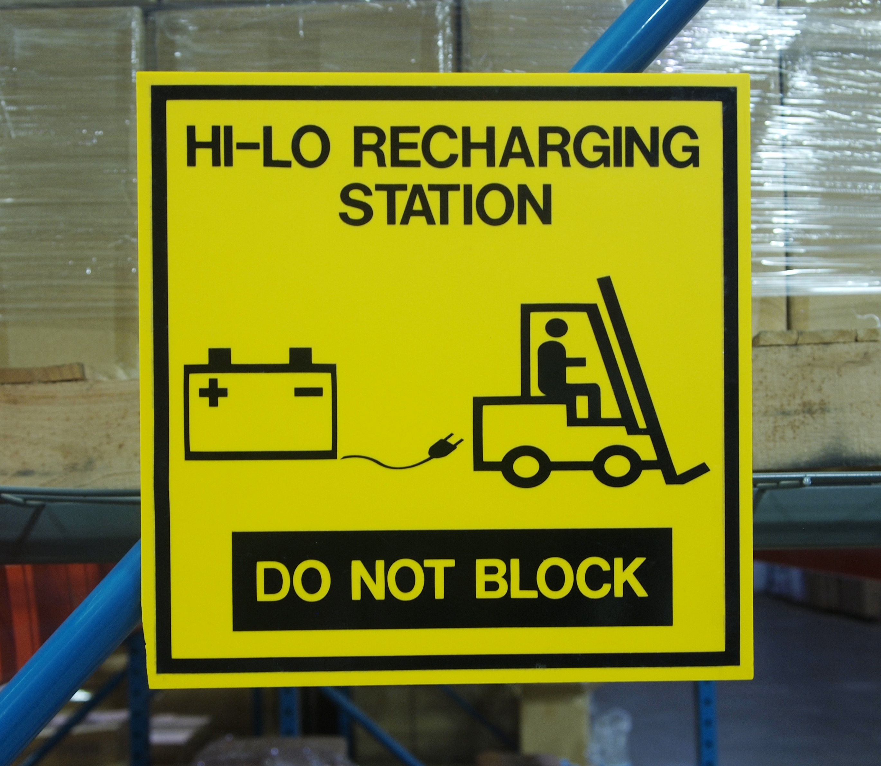
Visual Sign Shop Transforms Your Workplace
Go from this...
To this...
Durable
Professional
Affordable
No Size limitations
Signs on demand
Notes:
We want to share in more detail why is the Visual Sign Shop so valuable. This is a very powerful illustration! So many of us have needed a to communicate a message and did the best we could to with the tools we had. Your customers struggle to find the tools they need to make signs and visuals. With the Visual Sign Shop this problem is solved! You now have the ability to create signs on demand that are professional and give you message credibility for your standards. Your customer will be amazed how in a very short time, their workplace will be visually transformed into a visual, lean and safe facility.

Slide 9
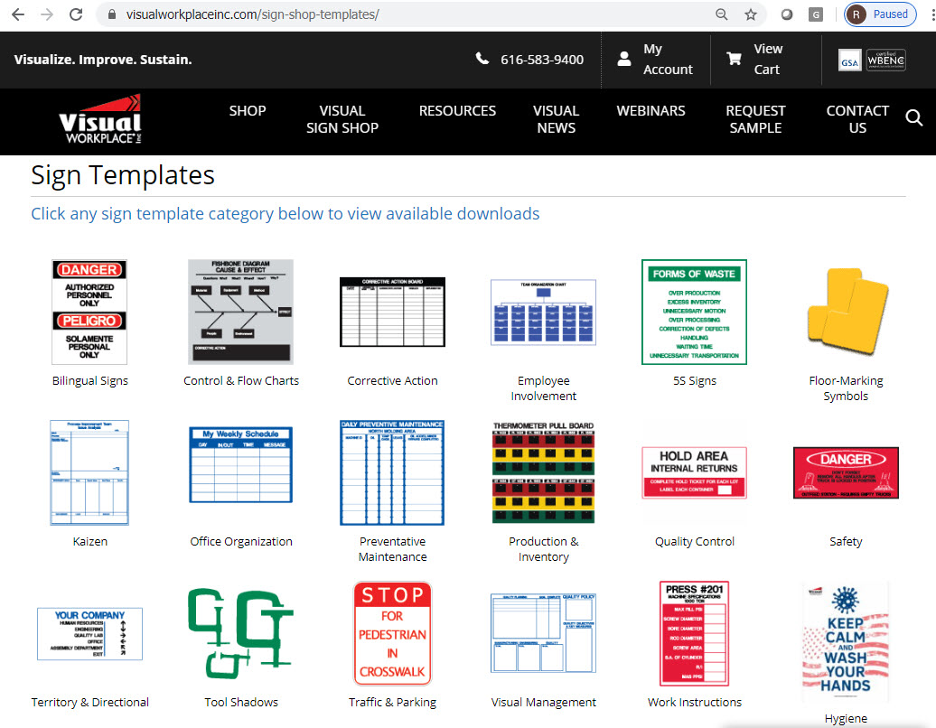

Visual Sign Shop Resources
Live Online Training
Training Videos
Webinars
Live Tech Support
Pre-made Templates
Logo Support
Custom Clipart
Retraining
Lifetime Unlimited Support
Notes:
It is important to note that we want to make sure your customer always has the resources they need. These resource do not cost the customer anything extra.
We have thousands of free tools to help get you started and keep improving processes. All the templates online can be downloaded and customized, or feel free to start from a blank canvas and create your own.
Most importantly for the distributor is that we want to keep-in-touch with the customer so if their resources change and they need a new person trained we are right there to assist and make sure they don’t have any disruptions in their sign making abilities.

Slide 10
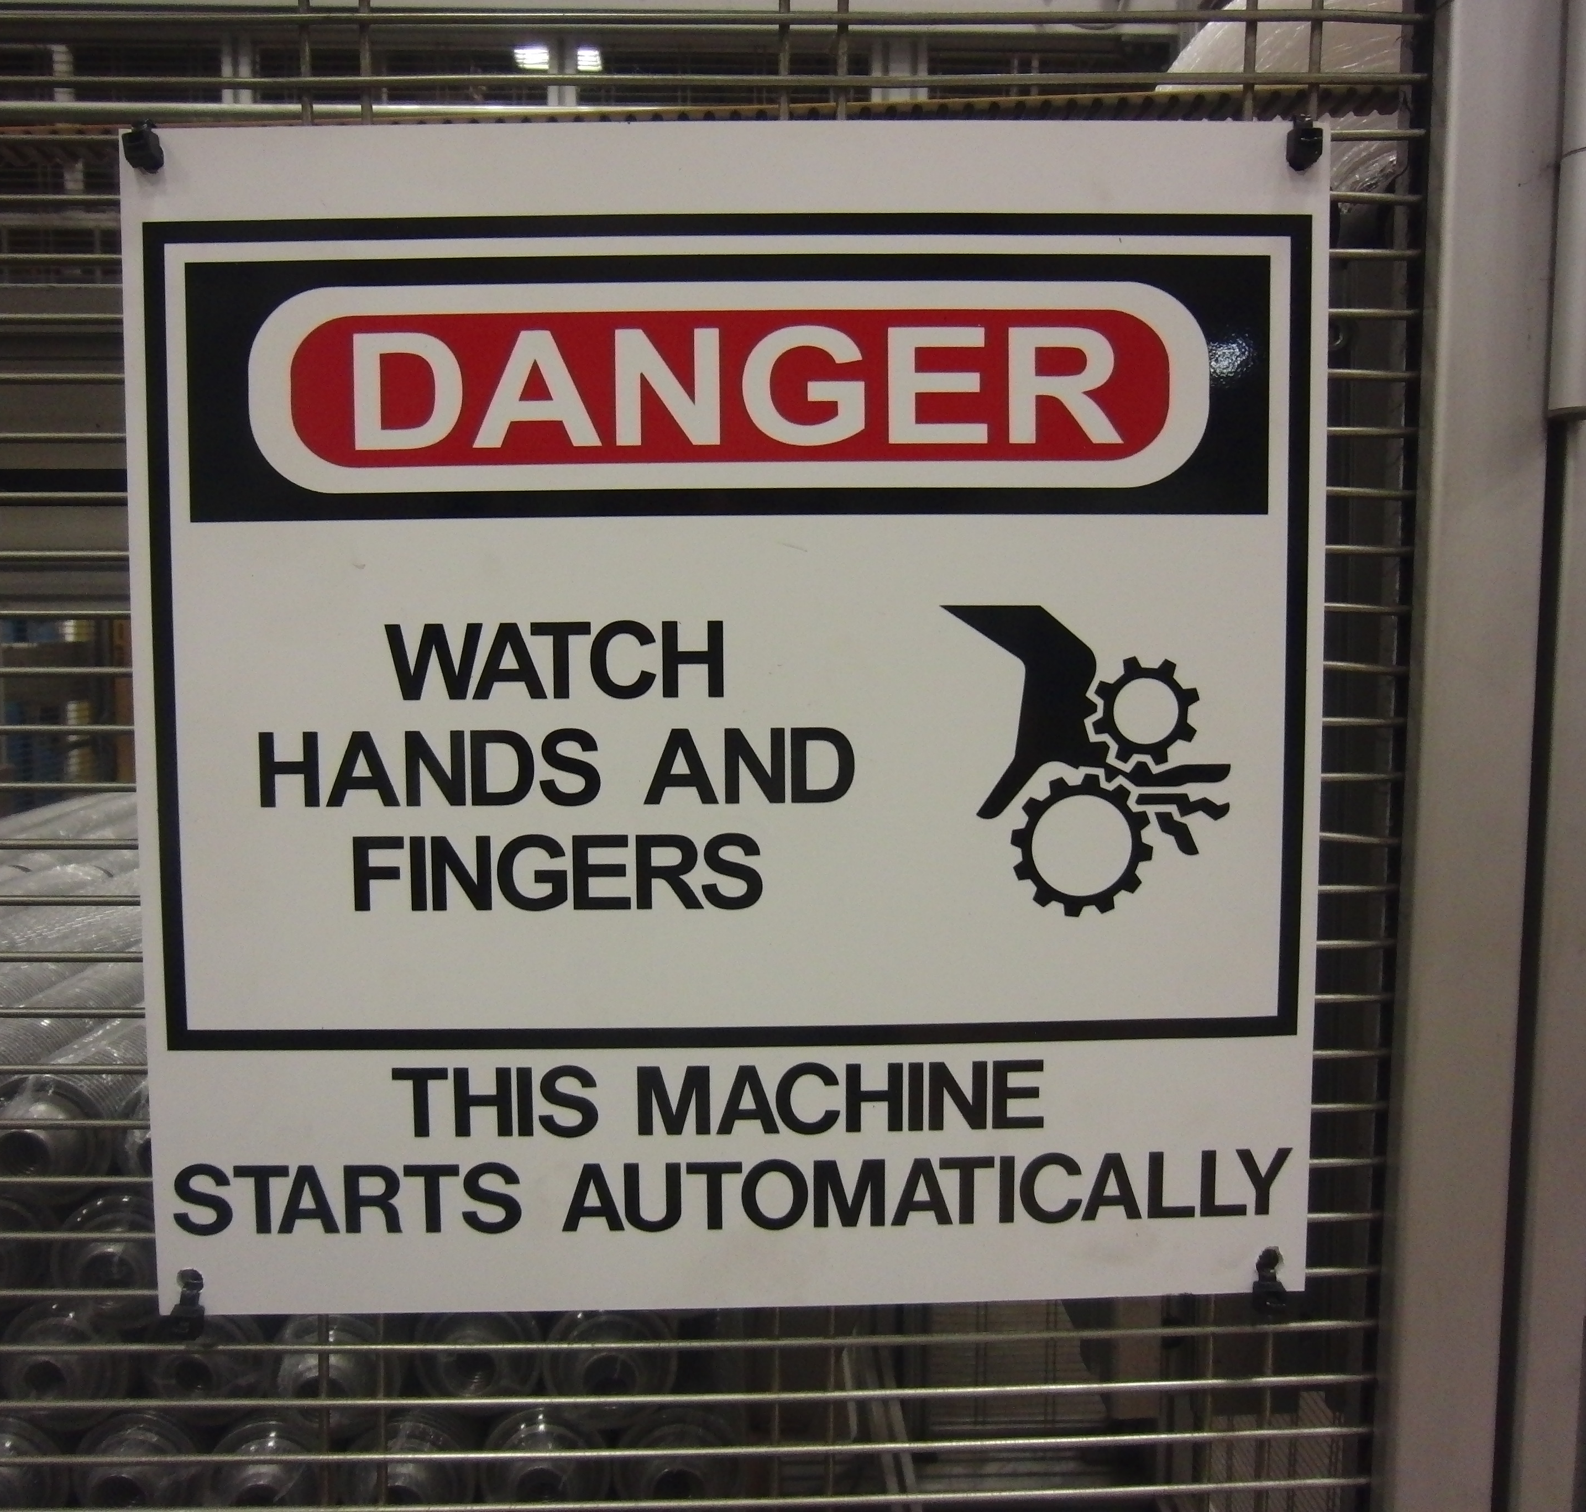
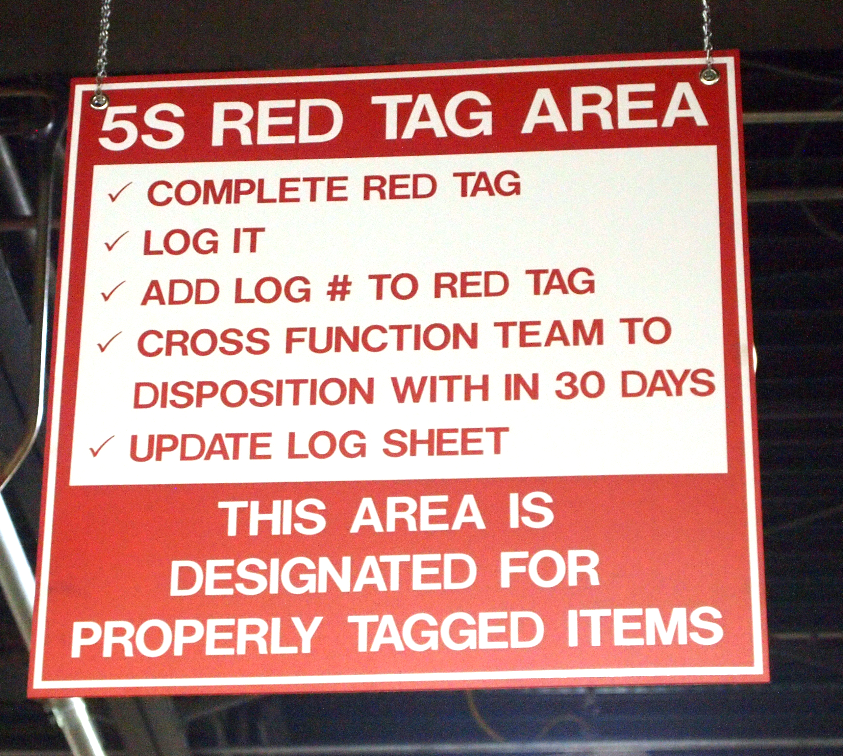


Compare the Cost!
Click to Evaluate
12x12 Sign
Buy It $13.25
Make It $2.59
Save $10.66
24x24 Sign
Buy It $43.80
Make It $10.65
Save $33.15
Evaluate the savings with our ROI Calculator
Notes:
Here you can see the cost savings with a 12x12 sign and a 24x24 sign on PVC with vinyl- We do have a real time live ROI on our website that you can pay around with putting numbers in and emailing a final report to yourself. Make it vs Buy it
It is important to note the materials that are included with the sign shop when the customer is evaluating the cost. If the customer calculates the cost to purchase these 64 signs compared to making them, the ROI is very quick.

Slide 11
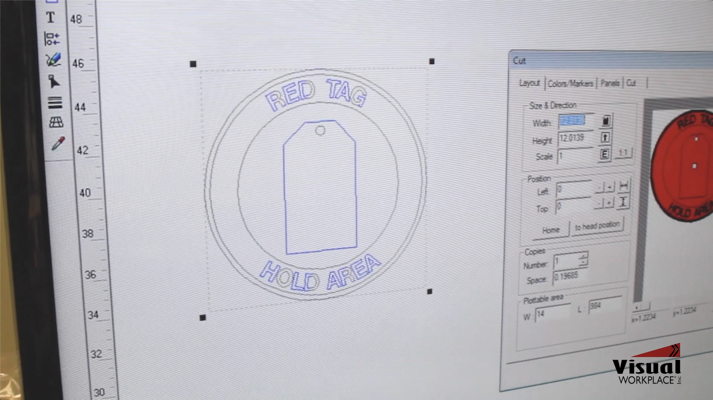
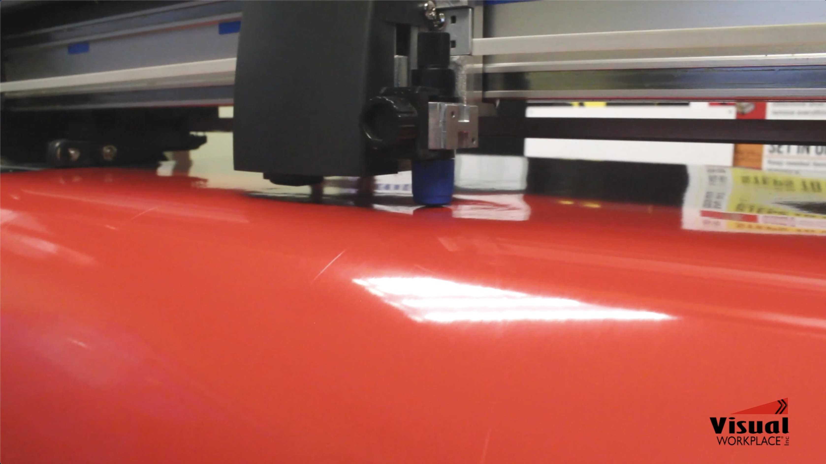
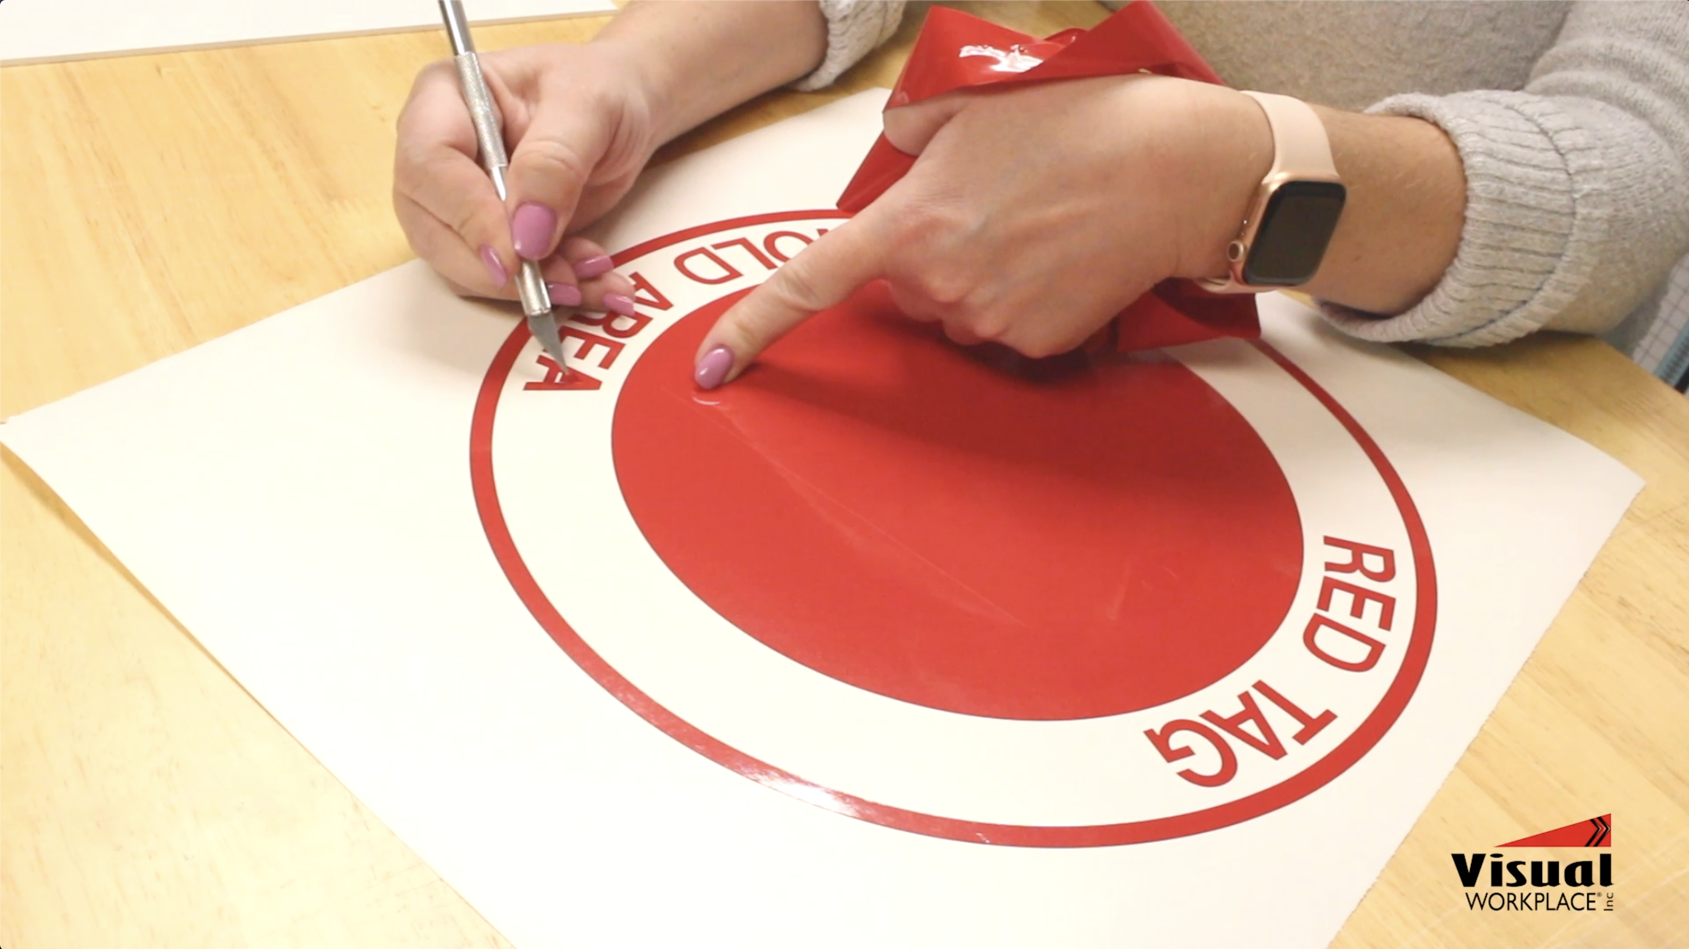
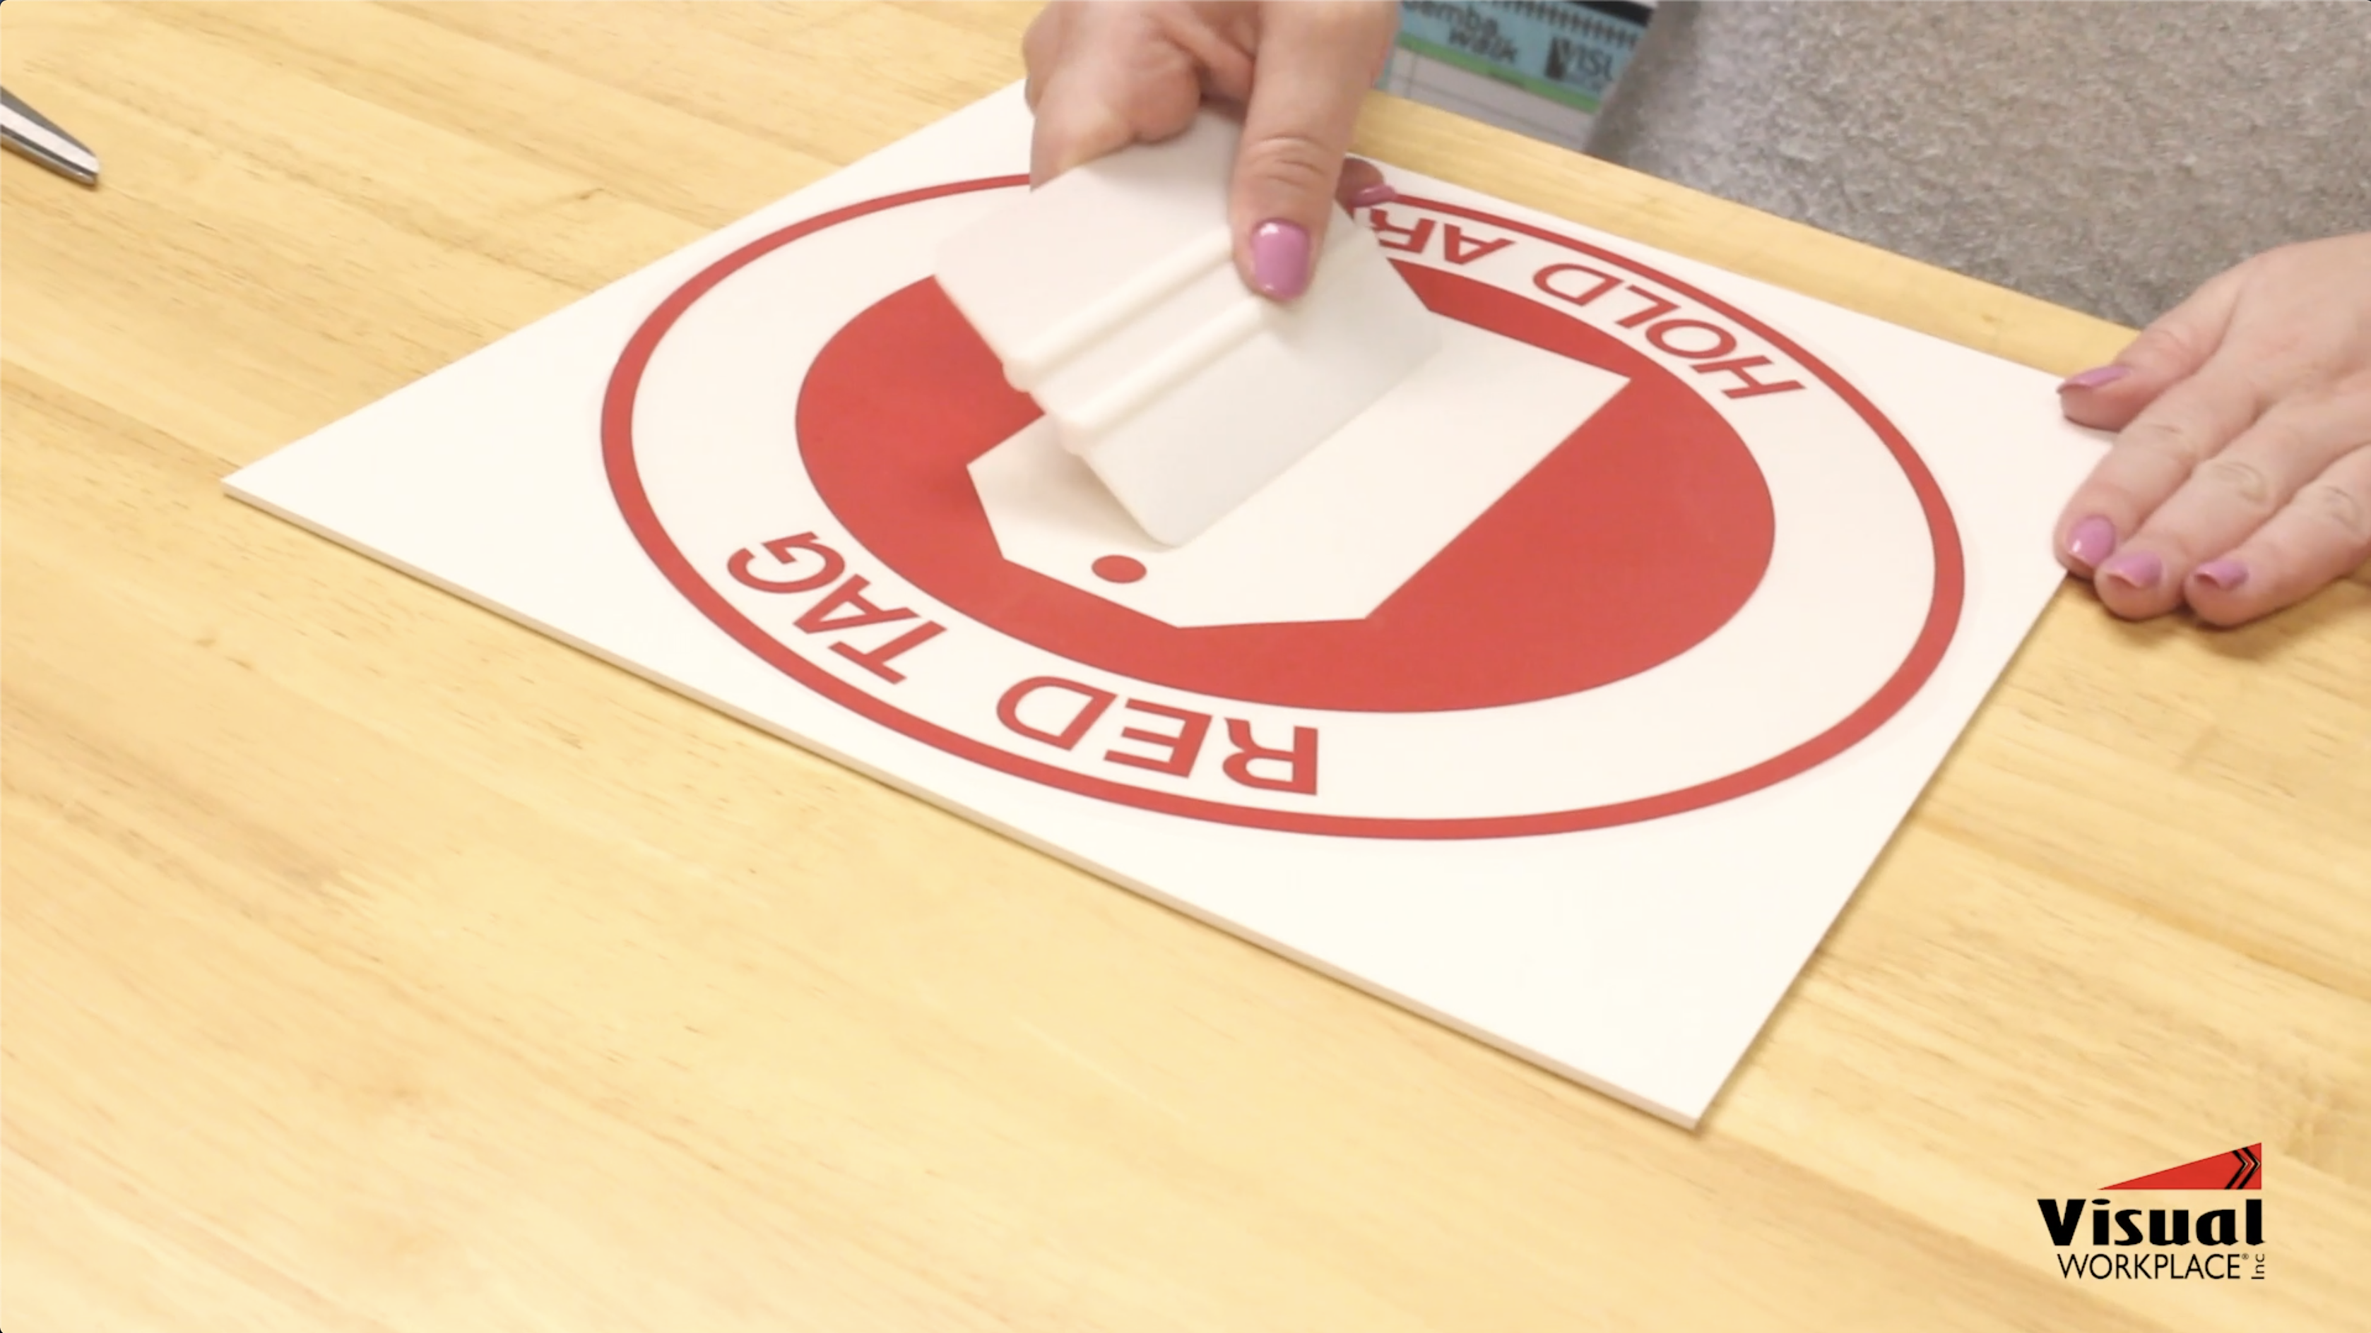
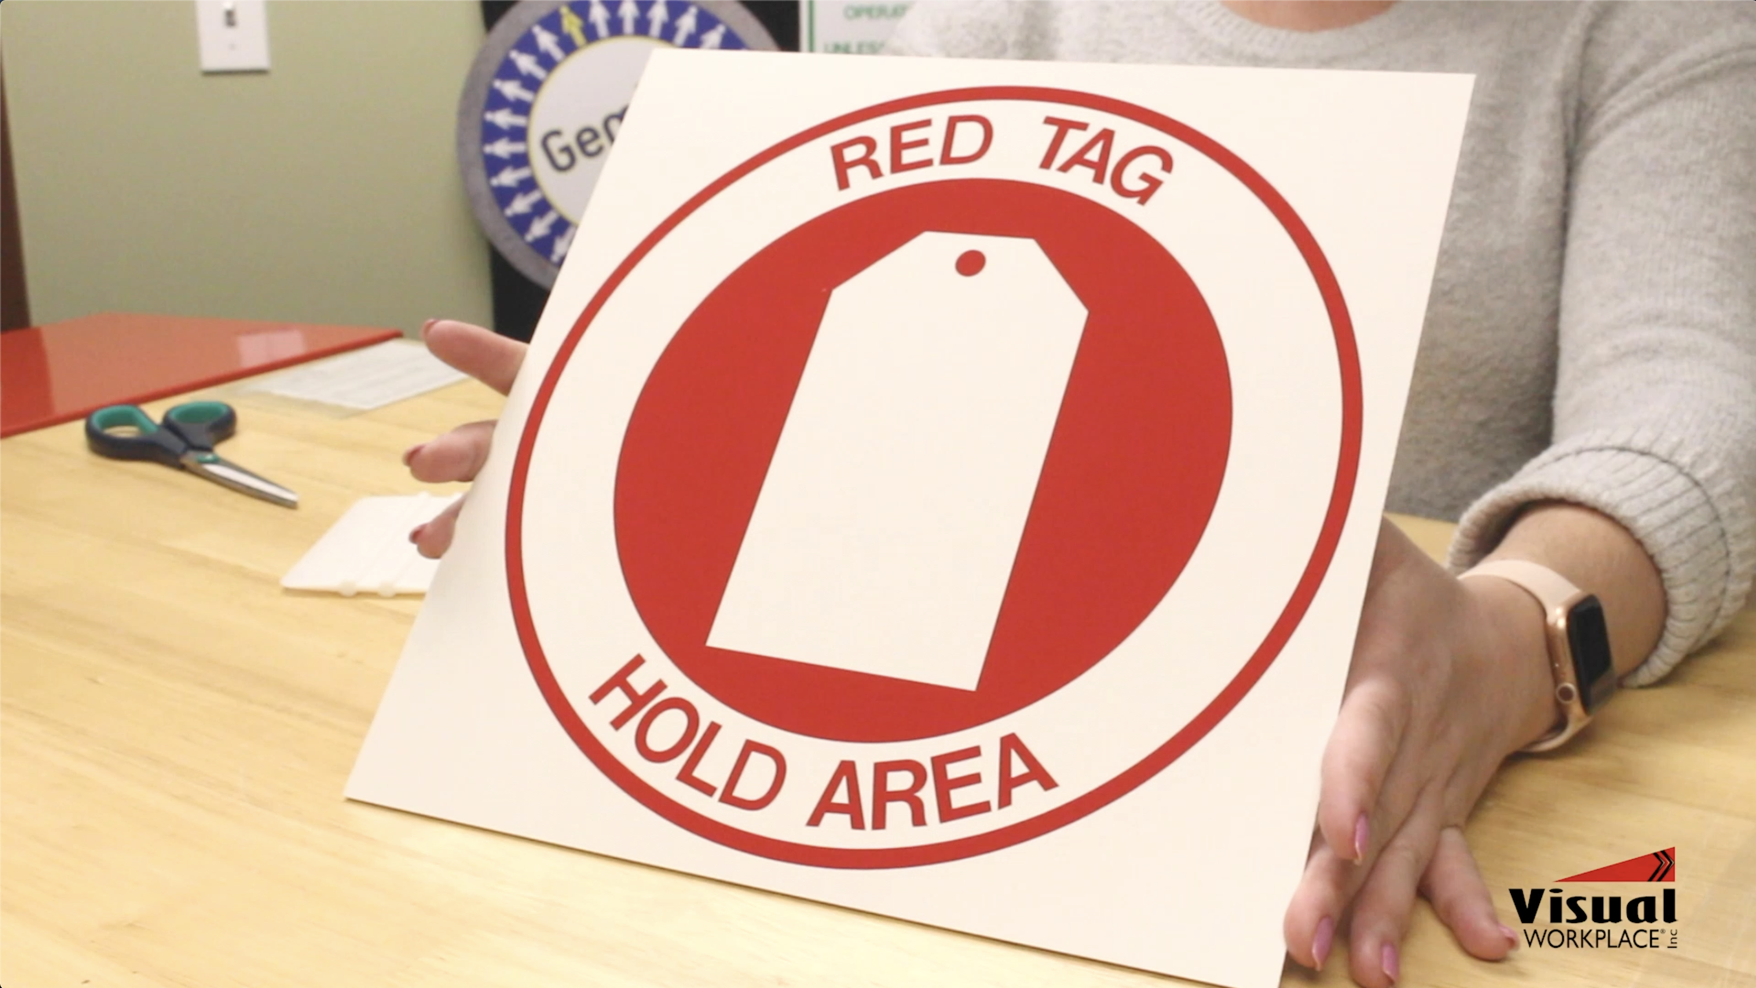
Create A Sign In Four Easy Steps
STEP 1: DESIGN
STEP 2: CUT
STEP 3: “WEED” & TRANSFER
STEP 4: APPLY
VIEW OUR 4 EASY STEP VIDEO
Notes:
You can create custom signs in 4 easy steps. If you have the chance to visit a customer, we can send you these steps so you can show them in person just without the plotter.
Click on video

Slide 12
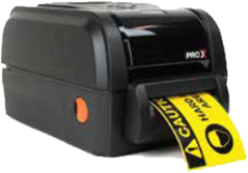
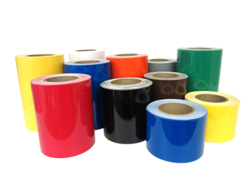
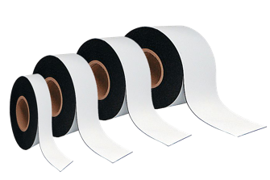


UPGRADE IT TO A PLATINUM PACKAGE!
Add a label printer for the smaller stuff
Vinyl Rolls 1” - 4”
Magnetic Rolls 1” – 4”
OSHA Header Labels
GHS Labels
Notes:
Many customers may have a need to make smaller visuals but don’t have the right equipment. We have solved this by bundling a label printer with the sign shop to create our Platinum version. This label printer in very reliable and cost effective.

Slide 13
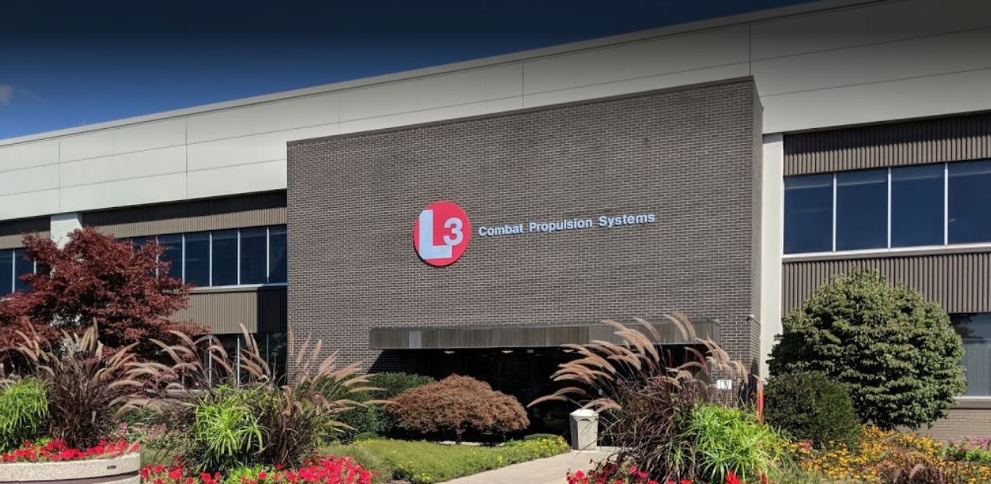
L3 HARRIS COMBAT PROPULSION CASE STUDY
CHALLENGE:
This facility was spending over $20,000 per year on signage
SOLUTION:
They implemented the Visual Sign Shop to internally create and customize visual communications
FIRST YEARS COST SAVINGS
Total Signs Made 181
Cost to Purchase $20,384
Cost to Make $3,330
Total Savings $17,054
“The sign shop and amazing support from Visual Workplace has been one of the biggest assets in the success of our Lean/5S program.” Naomi, L3Harris
Notes:
L3Harris Combat Propulsion Systems is an industry leader in the design and manufacture of military transmissions, suspensions and turret drive systems This facility has over a million sqft and dedicated their continuous improvement team to owning the sign shop and making it an integral part of their improvement goals.
The Visual Sign Shop tends to get high visibility within facilities as their workplace becomes transformed. Other locations, suppliers and customer start to ask “How did you do this?” This products promotes itself and consistently generates new opportunities on it’s own! Many leads come from existing customers.
Some distributors have asked about the impact on the of their current custom sign business and providing a make option. This is a fair question. We came at this from a different angle. We started with the sign shop and then offered custom signs. What you need to stress is now you have options for signage. You can do some yourself or let us do them. By offering options we have been able to grow the visual communication product category as whole and actually increases the overall spend with a customer. The sign shop cannot create every type of visual needed. They still will need custom signs for tool shadow boards, KPI and metric boards, PPE and more.

Slide 14
Call To Action
We will work with our distributors to create strategy to introduce the sign shop
Request Samples
Live Demo
20 – 30-minute live demonstration of the sign shop
Quote
Visual Sign Shop and supplies
Notes:
The sales tools we outline today will help support the customer call to actions. Customers are unique and may require information in different ways. Visual Workplace and OneSolution can assist in developing a strategy to introduce the Visual Sign Shop. It has been our experience that typically there is a sequence to the actions customers take as they learn more about the Sign Shop.
Samples are a great starting point that can be shared with others to create interest.
A live demo allows the customer to see how they sign shop works in real time and ask questions. It is helpful for the customer to have samples in hand during demo.
The good news is that 70% of the customers we quote end up purchasing a sign shop!

Slide 15
How Do We Help A Distributor Grow Their Business?
Generate customer cost saving solutions
Creates reoccurring revenue from sign making supplies
Provides an opportunity to expand visual communication products
Builds relationships and creates new contacts and exposure

Slide 16
Visual Sign Shop Sales Tools
Proposal (Share Point)
12-page overview showing the value of VSS along with the components of system
Training Overview for Distributors (Share Point)
How can we work together to maximize the customers use and capabilities?
Samples
We offer sample signs created with the VSS for customer to review
ROI Calculator
Calculate your payback comparing the cost to make vs buying a custom signs
Visual Sign Shop Product Overview (Share Point)
Visual Sign Shop Product Flier (Share Point)
Videos
The Visual Sign Shop
How to make a sign in 4 Steps
L3 Harris Case Study
Case Studies (PDF)
L3 Harris – Defense
Magna – Automotive
Southwest Cheese – Food
Ventra – Automotive
Notes:
Review list.
Links to the online documents are provided and are also available through Share Point.
If you are interested, we have also drafted email messages for each tool that you are welcome to use when communicating with your customers.
Our team is ready to help you in way that you might need. We can make the presentations, send samples and provide product demos.

Slide 17
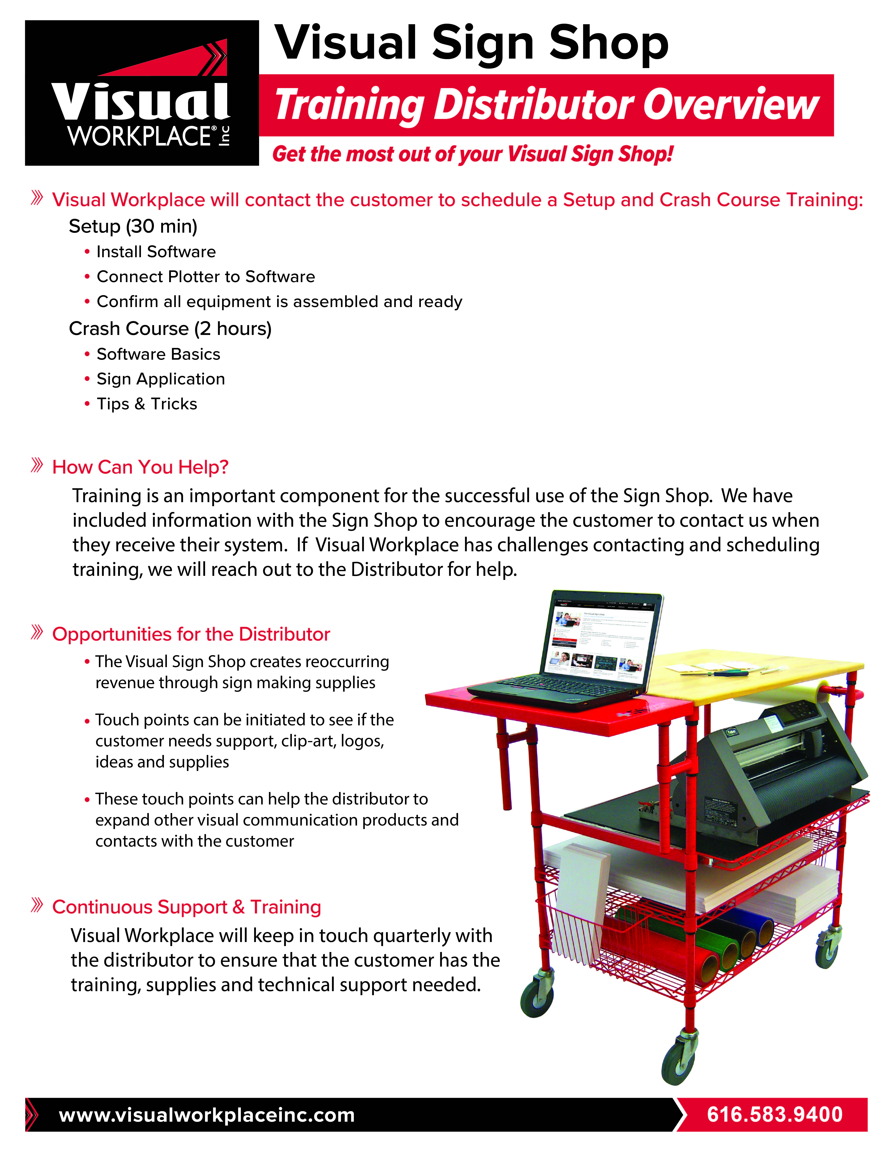
Training Overview
Visual Workplace Training
Setup call
Crash course training
How can you help?
Quarterly contact
Continuous Support
Retraining
Build relationships
Expand product categories
Get referrals
Feedback from OneSolution
Notes:
As part of our support program, we provide unlimited lifetime training. To ensure success we work very hard to engage customers to become trained. We need the distributors help to communicate this throughout the entire sales process. Once the customer receives their sign shop, they will have all of the information needed to reach out and schedule the training. Some do and then some don’t for many reasons.
When possible, we will try to capture the customer contact information and we will reach out. If we run into challenges, we will reach out to the distributor for help. It is in all of our interests to complete the training ASAP to start generating consumable sales on the supplies.
The final piece of our support program is our Quarterly Contact. This has proved to be very critical. We want to collaborate with the Distributor to make a quarterly touch with every sign ship customers. Our goal is to train as many people as the customer will allow but we know that people leave or change jobs. We need to stay connected with the customer and make sure they have people trained and if resources change, we are right there to get them up and running again. This quarterly touch also helps us build relationships, expand product categories and hopefully get referrals.
Our customers are amazed at the support we provide! It is a lot of work but worth every opportunity!

Slide 18
Next Steps
Questions
Suggestions
2021 Goals & Strategy
How do we work together?
Notes:
This brings us to the next steps!

